Slide 1
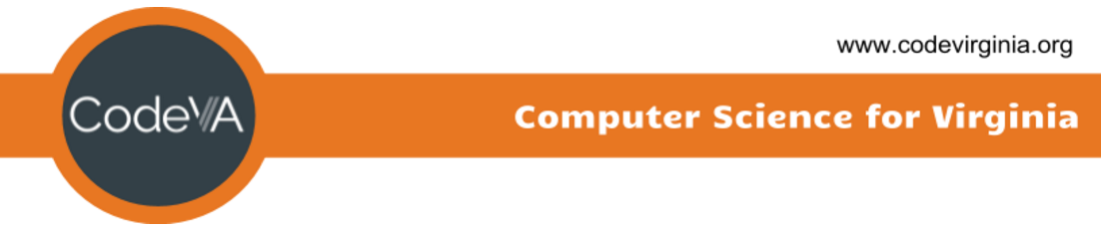
Intro to Coding
Conditionals - If Statements
Elementary Coaches Academy

Slide 2
Learning Objective
Become familiar with conditional statements in Python
Use chained conditionals
Learn logical operators

Slide 3
Definition: Conditional
A conditional is an expression that evaluates to either true or false

Slide 4
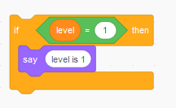

Definition: if statement
This statement checks a conditional (whether it is true or false) before running the code in the if statement’s body.
It only executes the code in its body if the conditional is TRUE

Slide 5
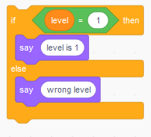

Definition: if-else statement
Similar to the if statement, the if-else statement also checks a conditional.
The difference is that the code in the else body is executed when that conditional is FALSE

Slide 6

Warm up
Open the starter File
https://repl.it/Lesson4WarmUp
Run the program by clicking the run button

Slide 7
Warm up
What conditional statement is used after the program asks if you like ice cream?
What happens if we don’t answer with ‘yes’ exactly? (Try it and see!)
Notes:
Conditional statement here refers to either if statement or if-else statement.

Slide 8
Warm up
Change the program so that it prints “That’s too bad :(“ if the answer is ‘no’
Challenge: Add “maybe” as a possible answer to the program’s ice cream question

Slide 9
Lab Lecture
Open the starter file
https://repl.it/Lesson4LabLecture

Slide 10
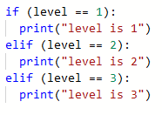
Definition: chained conditionals
Sometimes there are more than two possibilities and we need more than two branches.
For these cases, we use chained conditional statements.
Notes:
elif is an abbreviation of else if

Slide 11
Lab Lecture
Change the program so that it uses a chained conditional statement instead of just plain if statements
Ignore the last two lines for now

Slide 12

Definition: and operator
The and operator compares the truth value of two other conditionals.
If they are both true, the and conditional is true, otherwise it is false
Notes:
What is the truth value of (2 < 3)?
What about (1 + 1 == 2)?

Slide 13
Lab Lecture
Delete the comment symbols (the hashtags) from the code at the bottom of the program and run it again.
Note: the line is read as follows:
if answer is not equal to ‘yes’ AND answer is not equal to ‘no’
then execute code in body

Slide 14
Discussion
What happens now if we answer with ‘maybe’?
When is the last conditional statement true?
Notes:
Answer: the last conditional is true when answer is anything but ‘yes’ or ‘no’

Slide 15
Lab Lecture
Make the last if statement an else statement that is part of the chained conditional
Now what happens if we answer with ‘maybe’?

Slide 16
Lab Lecture
We have all seen > (greater than), < (less than), and = (equals) in math, but we are probably not all familiar with all the comparison and logical operators available in Python

Slide 17
Definition: logical operators
Logically evaluates a certain relationship of a conditional or between conditionals as either true or false
There are only three logical operators in Python
Operator | Example
<cond> and <cond> | (1 > 2) and (0 == 0)
<cond> or <cond> | (2 > 1) or (1 > 2)
not <cond> | not (1 + 1 == 2)

Slide 18

Definition: or operator
The or operator compares the truth value of two other conditionals.
If either is true, the or conditional is true, otherwise it is false

Slide 19

Definition: not operator
The not operator reverses the truth value of a single conditional.
It simply inverts the truth value of that conditional. In other words, true becomes false, false becomes true.

Slide 20
Definition: comparison operators
Logically evaluates a relationship between two values as either true or false
These do not operate on conditionals!

Slide 21
Definition: comparison operators
Operator | Description | Example
== | left is equal to right? | 0 == 0 is True
!= | left is not equal to right? | 1 != 0 is True
<> | left is not equal to right? | 1 <> 1 is False
> | left is greater than right? | 2 > 4 is False
< | left is less than right? | 2 < 4 is True
>= | left is greater than or equal to right? | 3 >= 4 is False
<= | left is less than or equal to right? | 3 <= 3 is True

Slide 22
Discussion
Unlike in common English, in computer science, ‘or’ is considered true if both values are true.
For instance, I don’t think Patrick Henry would have been okay with both liberty AND death!

Slide 23
Lab Lecture
Add the winter hat sprite to the stage (on the squirrel) if the answer is no and when the squirrel is leaving (after he asks you about ice cream)

Slide 24
Practice Exercises
LINK
Mild - perfect for beginners
Medium - expanding your skills
Spicy - looking for a challenge?

Slide 25
Journal
Can you think of a content area in the topics that you already teach where if/else logic or conditionals could easily be integrated or is relevant?

